Slide 1
Development of Computer Vision and Image Processing Libraries at NSLS-II
William Watson
Kazimierz Gofron

Slide 2
Purpose
Development of image analysis software integrated with EPICS control system.
Computer Vision for synchrotron beamline applications.
Develop easy to use python modules to access computer vision functions backed by OpenCV.
Optimized results for fast computation, via C++, Intel IPP/TBB.
Automate processes from image input such as:
Positon, spread, and intensity of X-Ray Beams
Isolating and computing data on multiple objects
Provide assistance to mounting samples and report any errors

Slide 3
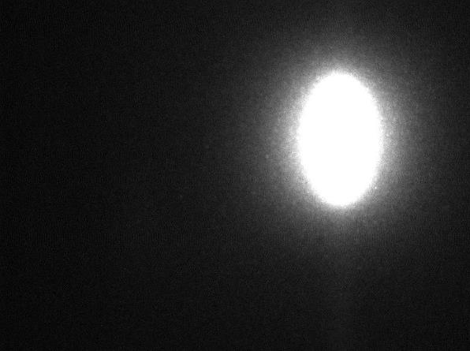
BPM-1 X-Ray Analysis (IXS)
Purpose:
Discover Position of Beam
Discover Spread of Beam
Discover Intensity of Beam
Discover the Centroid of the Beam
E = 9.1 keV
Scintillator: YAG
Camera: Prosilica
Magnification: 5x
Images Courtesy of: Yong Cai, Alessandro Cunsolo, Alexey Suvorov, and the IXS Beamline Staff

Slide 4
BPM-1 X-Ray
Located in B Hutch (IXS)
1st XBPM
2nd XBPM
3rd XBPM
Images Courtesy of: Yong Cai, Alessandro Cunsolo, Alexey Suvorov, and the IXS Beamline Staff

Slide 5
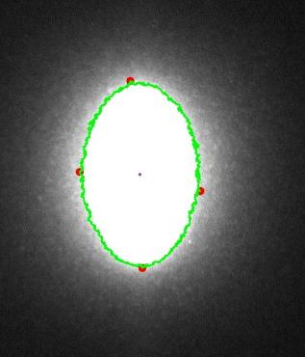
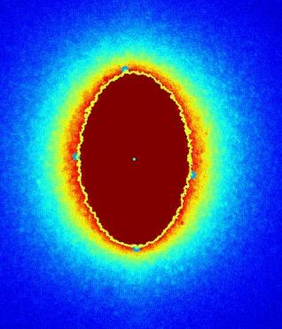
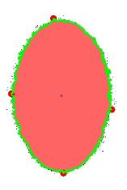
BPM-1 Data Results
Console Output:
Object Details:
perimeter: 2356.99022925
orientation: 179.838363647
max: (925, 198)
height: 372
extrema: {'B': (938, 568),
'R': (1054, 415),
'L': (813, 377),
'T': (914, 196)}
area: 65058.5
min: (1047, 564)
sum intensity: 20426526
width: 241
centroid: (933, 382)
mean intensity: 227.842390577
Result Superimposed on Original
Jet Color Map
Thresholding Result
Images Courtesy of: Yong Cai, Alessandro Cunsolo, Alexey Suvorov, and the IXS Beamline Staff

Slide 6
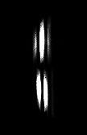
Analysis -Merlin Quad X-Ray Detector (IXS)
Data Retrieved from the Merlin Detector at IXS
Purpose:
Isolate Individual Streaks
Process each Streak to learn Position, Center, Spread, Intensity, Max Values, etc.
Count Intensity in each streak
E = 9.1 keV
Direct detection
PEL size = 55 [um]
Images Courtesy of: Yong Cai, Alessandro Cunsolo, Alexey Suvorov, and the IXS Beamline Staff

Slide 7
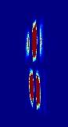

Merlin Data Results for First Object (Largest)
Console Output:
Object 1:
perimeter: 125.840619564
orientation: 179.981033325
max: (131, 78)
height: 55
extrema: {'B': (129, 122), 'R': (135, 98),
'L': (126, 92), 'T': (132, 67)}
area: 270.5
min: (134, 83)
sum intensity: 62689
width: 9
centroid: (130, 95)
mean intensity: 126.644444444
Images Courtesy of: Yong Cai, Alessandro Cunsolo, Alexey Suvorov, and the IXS Beamline Staff

Slide 8
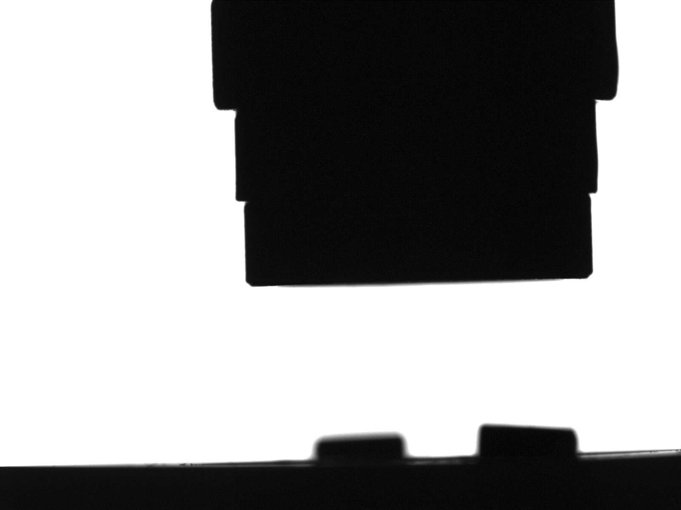
ABBIX Beamlines (AMX) – Pins in a Robotic Gripper
Purpose:
Find if Pin is in the Gripper
Determine if Pin is properly mounted
Analyze the position of the Gripper and Pin within the image
Find the Region of Interest (ROI) for the Pin and Gripper
Compare the Pin and Gripper to a ‘Perfect’ Image to determine if anomalies are present
Advise the user to any potential problems
Discover kinks, check mounting
Discover center of mass
Use extrema for alignment assistance
Images Courtesy of: Jean Jakoncic, AMX Beamline

Slide 9


ABBIX Beamlines (AMX): Pins in a Robot Gripper
Images are from AMX, Displays a Pin and a Gripper, in an attempt to grab the pin
Pin and Gripper ‘Perfect’ Image
Pin Template Image
Gripper Template Image
Images Courtesy of: Jean Jakoncic, AMX Beamline

Slide 10
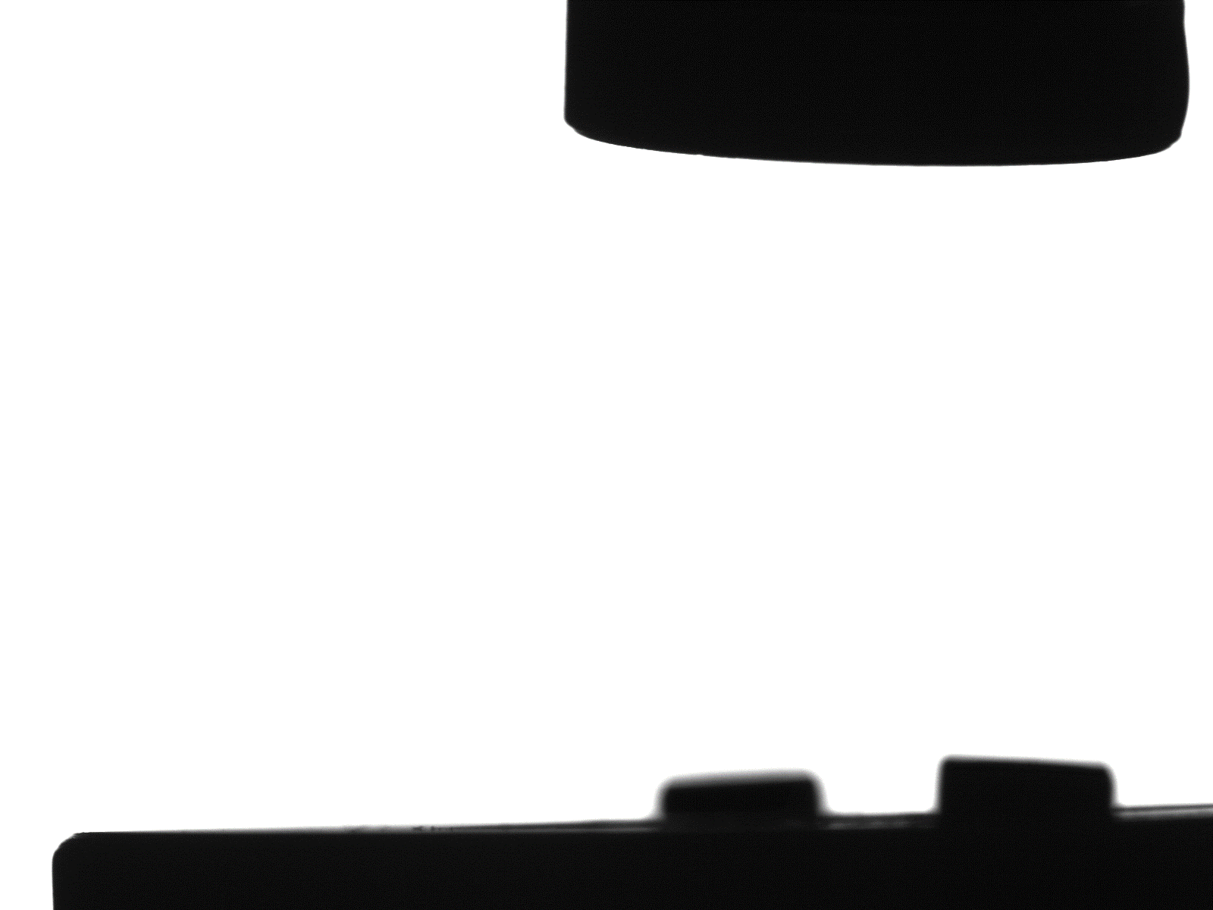
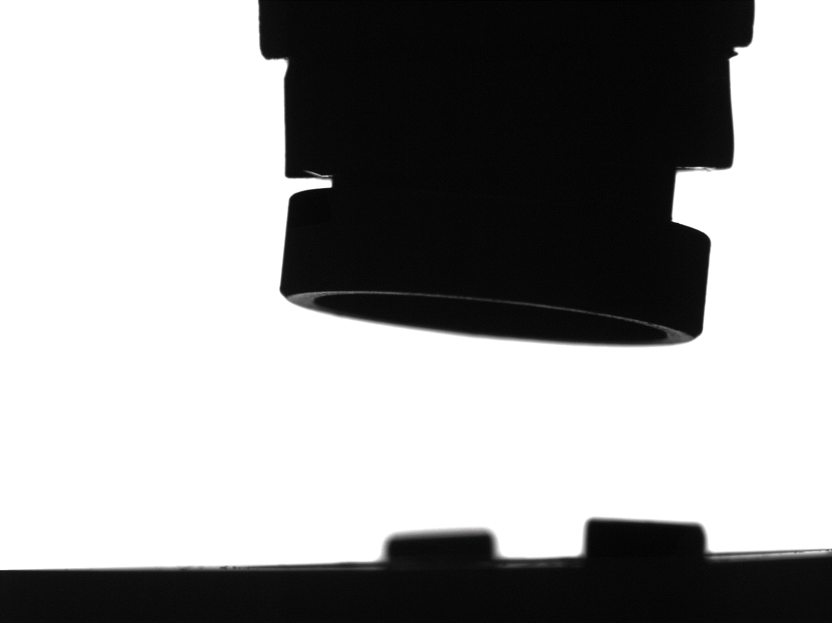

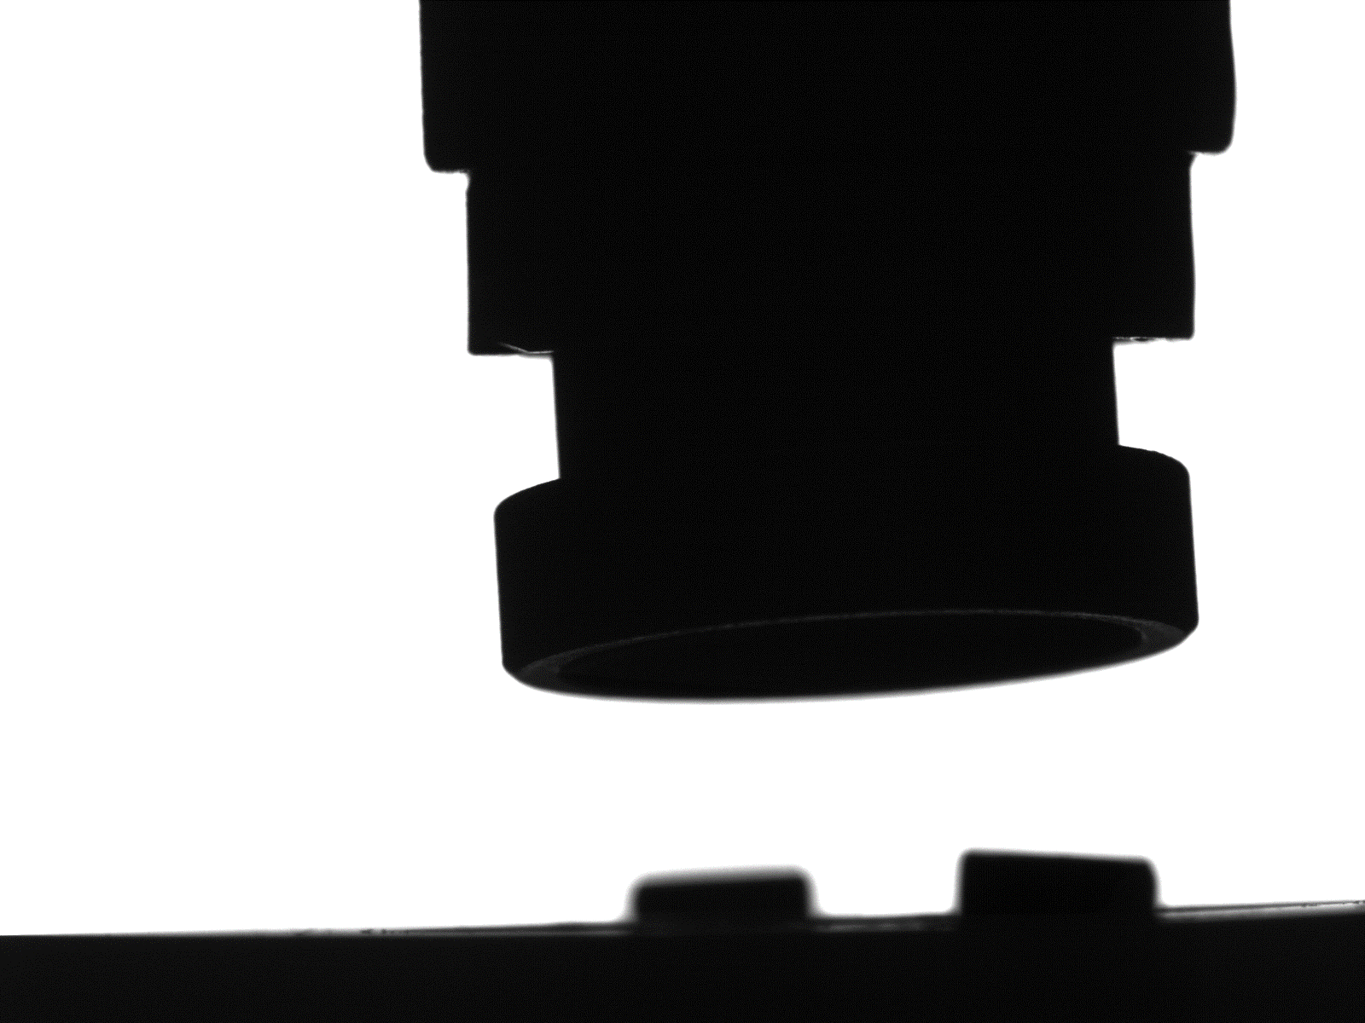
Pin/Gripper – ‘Perfect’ vs Test Cases
Image 1
Image 2
‘Perfect’
Image 3
Image 4
Images Courtesy of: Jean Jakoncic, AMX Beamline

Slide 11
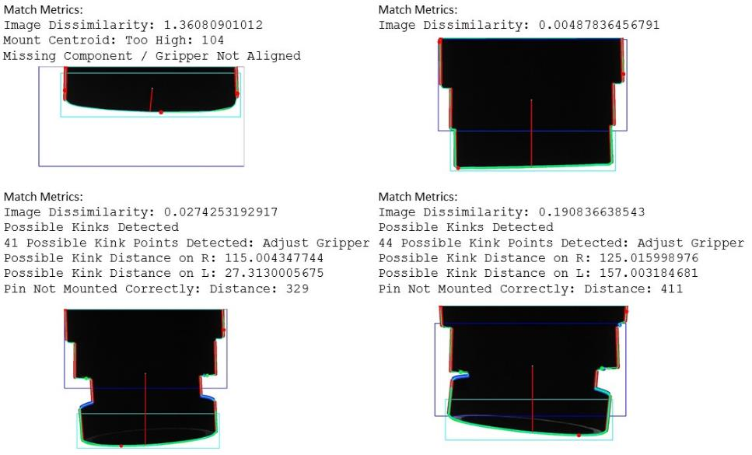
Pin/Gripper Image Analysis – Results
Images Courtesy of: Jean Jakoncic, AMX Beamline

Slide 12
Crystal Rotational Alignment - AMX
Purpose:
Locate the Crystal
Center the Crystal in Goniostat
Plot as a function of angles the Y Pixel coordinate of Crystal during rotation
Images Courtesy of: Jean Jakoncic, AMX Beamline

Slide 13
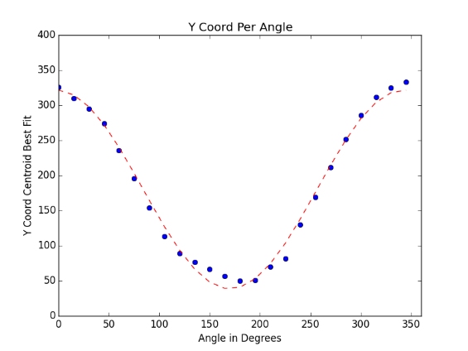
Crystal Rotational Alignment - AMX
Centering Crystal:
Images Courtesy of: Jean Jakoncic, AMX Beamline

Slide 14
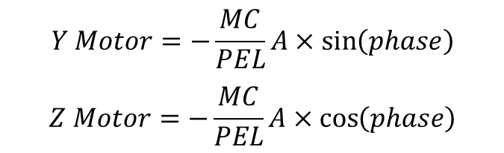
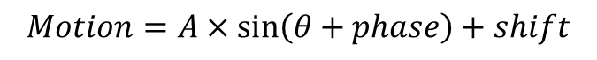
Loop Centering - AMX
$$Y Motor=−\frac{MC}{PEL}A×\sin\left(phase\right)$$
$$Z Motor=−\frac{MC}{PEL}A×\cos\left(phase\right)$$
$$Motion=A×\sin\left(θ+phase\right)+shift$$
Images Courtesy of: Jean Jakoncic, AMX Beamline

Slide 15
Conclusion
Computer Vision is integrated with EPICS control system.
Computer Vision provides:
Center Samples in Goniostat (ABBIX, IXS, etc.)
Automated Robotic Mounting and Sample Detection (AMX)
Assist in alignments of samples, crystals, and beams
Discovers and reports information about objects within an image
Prevent potential problems by alerting users of anomalies
With OpenCV 3.1.0 and the Intel IPP Library, all CV functions run at optimized speeds, providing the best computational results currently available.

